Slide 2
WHAT IS COMMERCIAL ARTS ?
Any artwork associated with commerce or promotion
WHAT EXACTLY DOES THIS MEAN ?
Your job as a designer in this class will be to clearly (and as precisely
as possible) illustrate your point visually rather than verbally.
Attention spans of consumers and people you are designing things for
are growing shorter and shorter. Therefore, it is necessary for you to
create commercial artwork which includes any combination of clever,
engaging, clear, easy to understand, humorous or serious artwork, text,
messages and imagery.

Slide 3
COMMERCIAL ART IS...
Artwork associated with commerce or promotion

Slide 4
COMMERCIAL ARTISTS CREATE
The visual part in communicating a message

Slide 5
COMMERCIAL ARTISTS CREATE
“The visual part in communicating a message…”
What message is being communicated in this poster?
A commercial artists was responsible for creating:
The headline
Color combination
Chose the fonts
Created or found the artwork
Typeset the entire thing
Laid out the entire design

Slide 6
By the end of the 18 weeks, you should be able to:
Describe what commercial arts is and how it’s created
Explain specifics of how artwork is created using the design process
Analyze industry rules about how this industry works
Reason your way through problems in the class projects based on what you have studied and practiced.
Prove by practical applications that you have a solid, basic understanding of commercial arts and at least three to five areas of it common to the industry
Apply what you have learned to a final project which will incorporate many of the skills taught during the semester.

Slide 7
Careers in Commercial Art include:
Web Designers
Graphic Artists
Illustrators
Cartoonists
UI/UX Designers
Icon Set Design
Printing Industry
Package Designers
Set Designers
Art Directors
Photographers
Digital Illustrators
Billboard Artists
App Design Branding

Slide 8
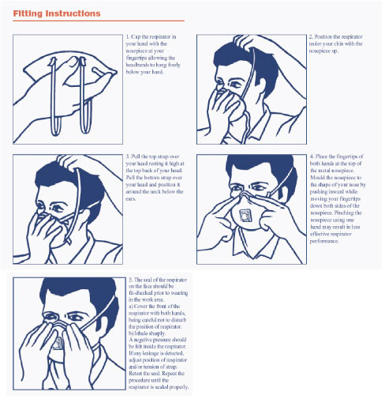
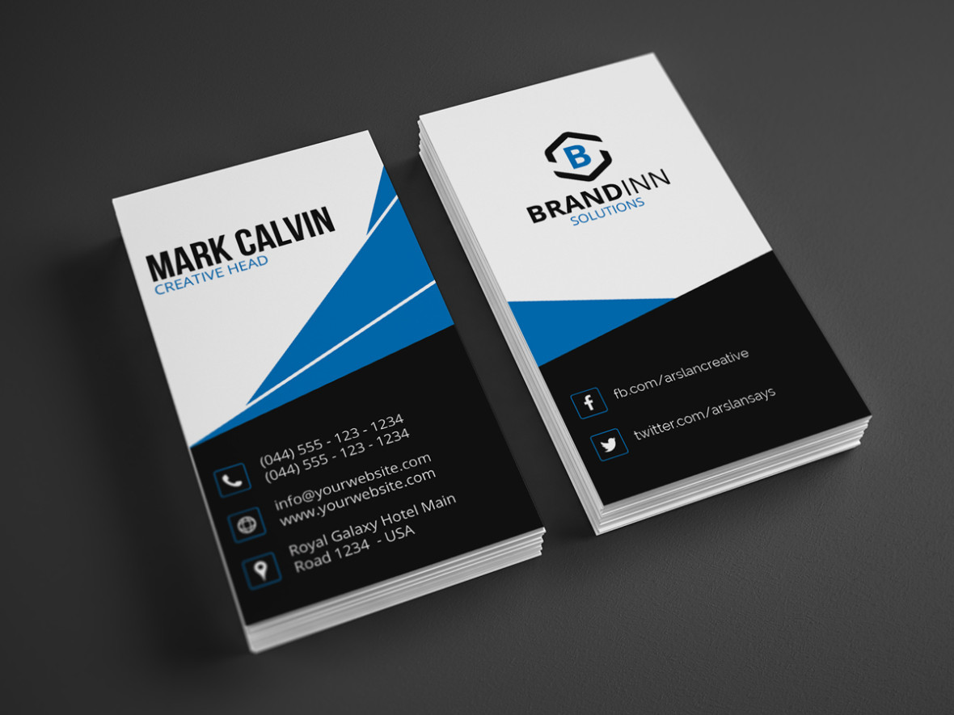
We develop design artwork for websites, logos, stationery,
print ads, signage, film and video, diagrams, posters, flyers & brochures.

Slide 9
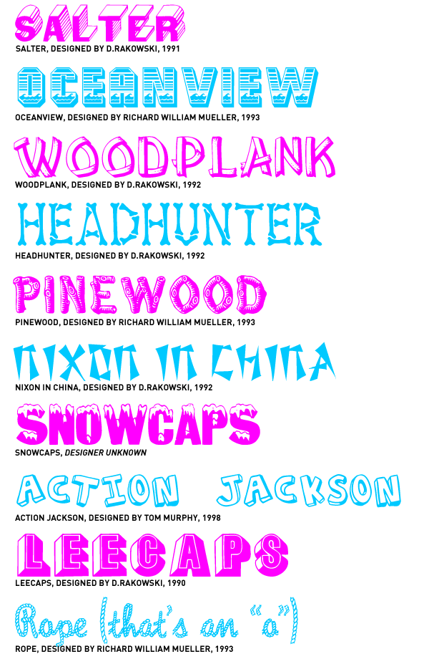
We create font, lettering and illustrations for a variety of industries.

Slide 10
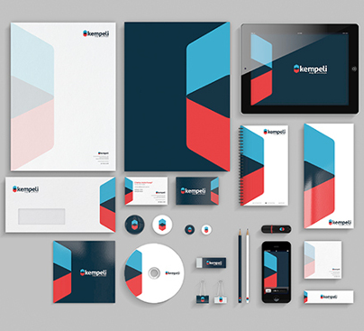
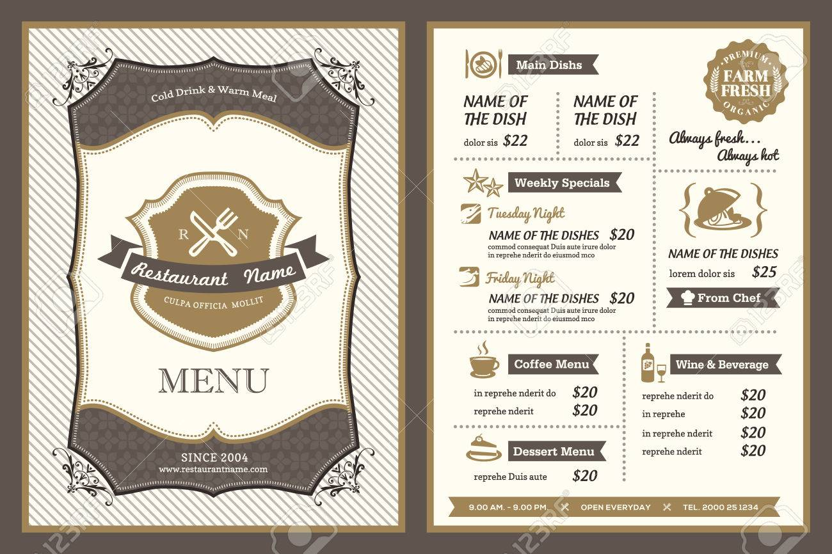
We create page layouts and work with clients to help visualize their needs

Slide 11
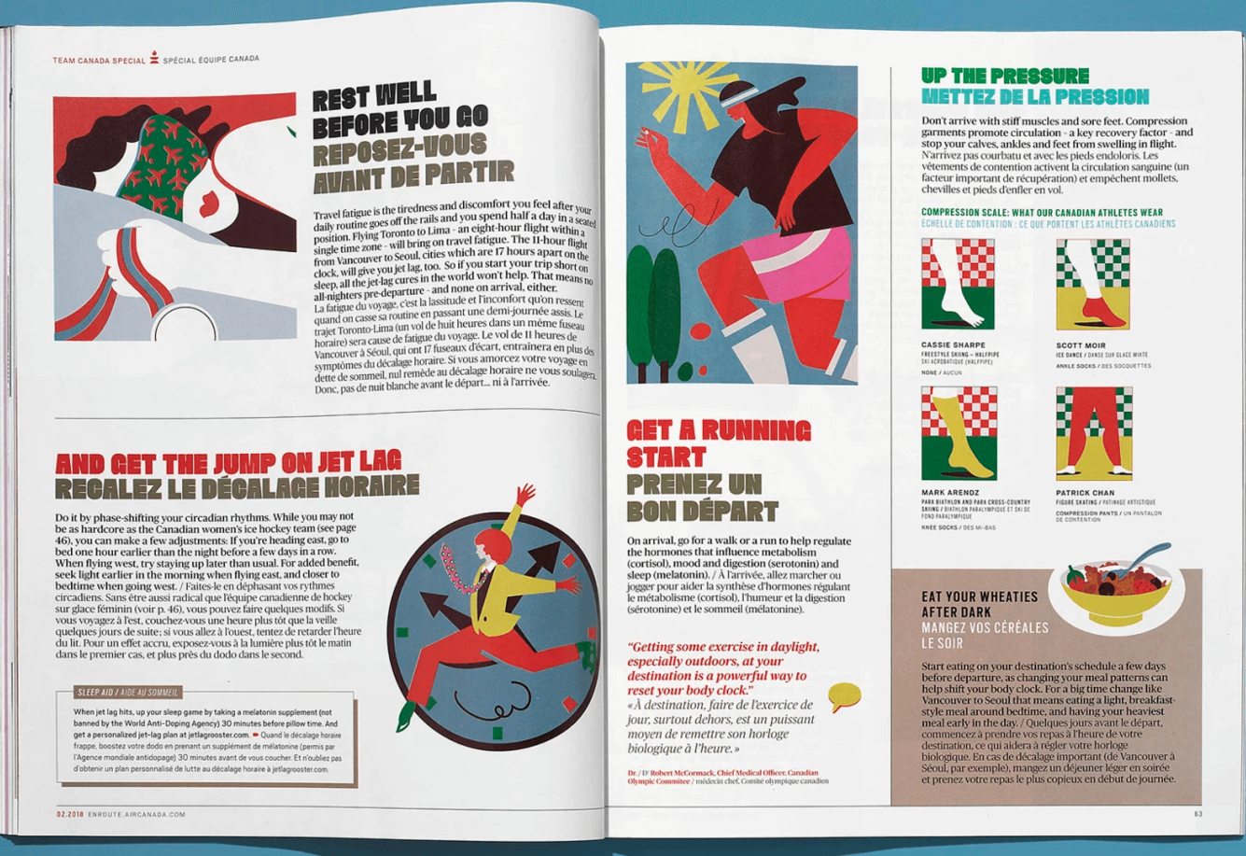
We put pictures on t-shirts, oversee the layout of annual reports,
magazines and newspapers

Slide 12
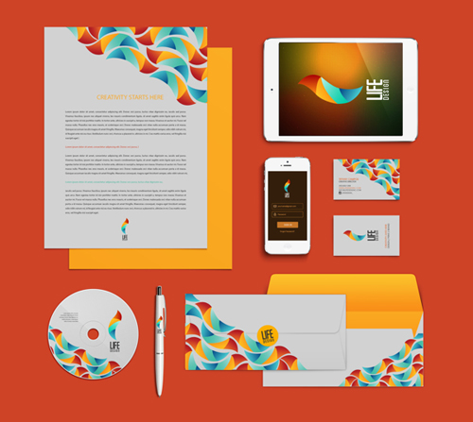
We create visual identities, branding and artwork for cross platforms

Slide 13
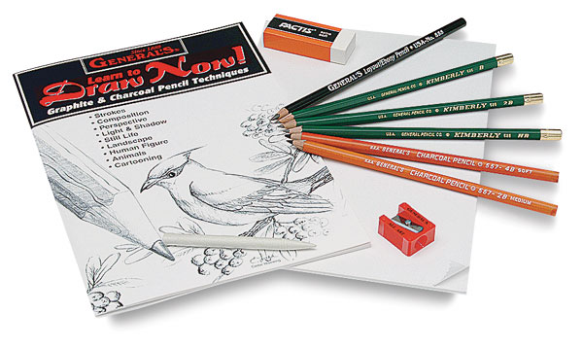
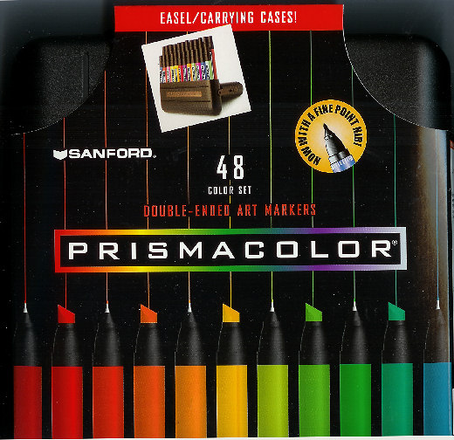
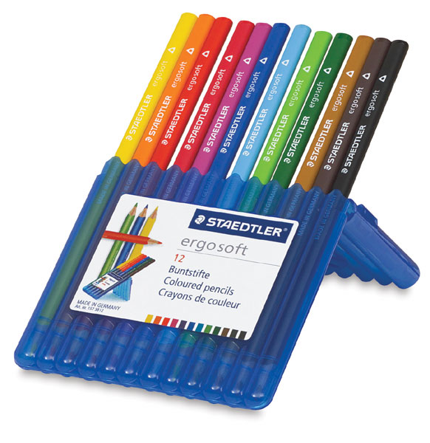
We complete work by hand in various mediums such as marker, ink, pencil

Slide 14
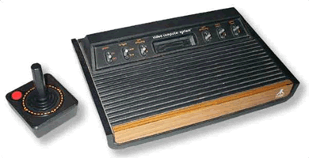
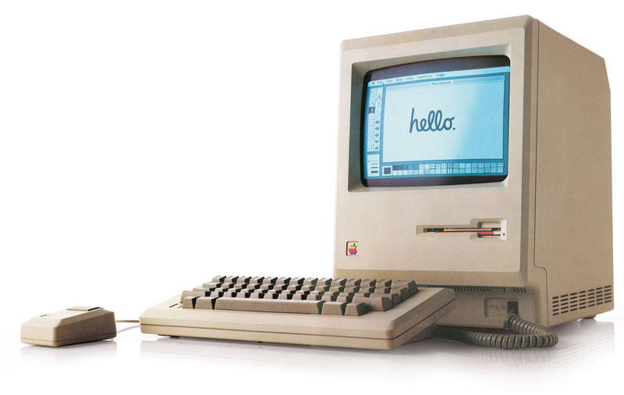
We use computers and software to complete the job.

Slide 15
WHAT SKILLS ARE IMPORTANT?
Idea Generation & Evaluation - Generating a number of different approaches to problems and then evaluating the likely success of an idea.
Fine Arts - Knowledge of theory and techniques required to produce, compose, and
perform works of music,dance, visual arts, drama, and sculpture.
Design - Knowledge of universal design techniques, principles, fonts and type.
People Skills - Working and playing well with others. Brainstorming
ideas with several other people to come up with the best solution to a problem. Accepting constructive criticism and meeting deadlines on time.
Computer Skills - Working with and understanding widely used industry standard software
such as Adobe Photoshop, Adobe Illustrator or Corel Draw, Adobe
In-Design, ImageReady, Acrobat, Quark Express and more.
Originality - The ability to come up with unusual or clever ideas about a given topic or situation, or to develop creative ways to solve a problem.
Visualization - The ability to imagine how something will look after it is
moved around or when its parts are moved or rearranged.
Color Theory - The ability to match or detect differences between colors including shades, brightness and color trends

Slide 16
WHAT IS MOST DETRIMENTAL TO YOU
Cell phone use or texting in class.
Killing time accessing websites that have nothing to
do with our class
Off Task / Not Working / Doing Nothing / Sleeping
Doing work from another class when you have something to finish here
Out of your seat, and where you shouldn’t be
Pre-occupying other students time
Talking over me or when I’m addressing the class
Use of earbuds in class.
Please also, no sunglasses or hoodies up.
Excessive, loud, off topic conversations…

Slide 17
HELP YOU HELP YOURSELF
Challenge yourself. Try new things.
Participate. Get involved.
Talk about your ideas. Bounce them off people in the class.
Bring two things with you every day:
An Open Mind and a Pencil
Embrace the unknown. The faster, you do the faster you go.
Help someone else. Show them a technique or website or band or drawing style.
Be here. Be present. Mind and body.

Slide 18
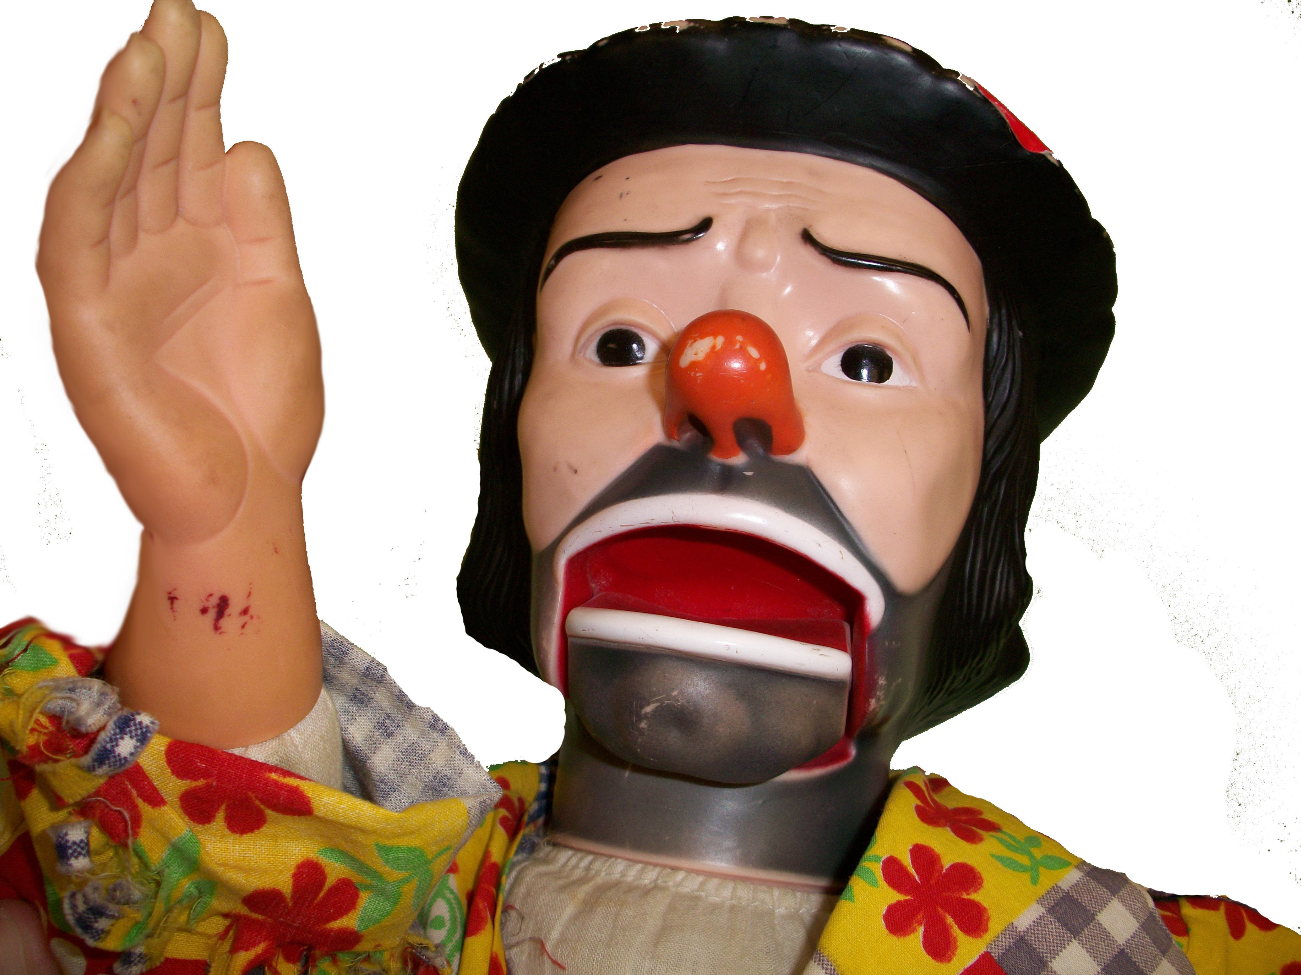
Are you ready to start?
Take advantage of opportunities.
Have fun. Get weird. Learn new everything.
Know when to listen.
Let your artwork change you.
I hope you enjoy the class!

