Slide 1
Abstract Art

Slide 2
Characeristics
colour
shape
Form
texture
line
value

Slide 3
Where abstract art originated from
Abstract art originated in Europe in the late 19th century. Abstract art fully emerged in the early 20th century

Slide 4
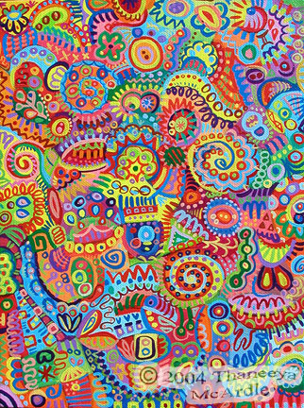

Slide 7
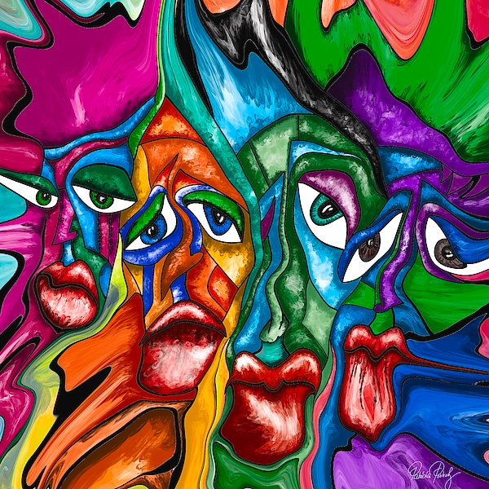

Slide 10
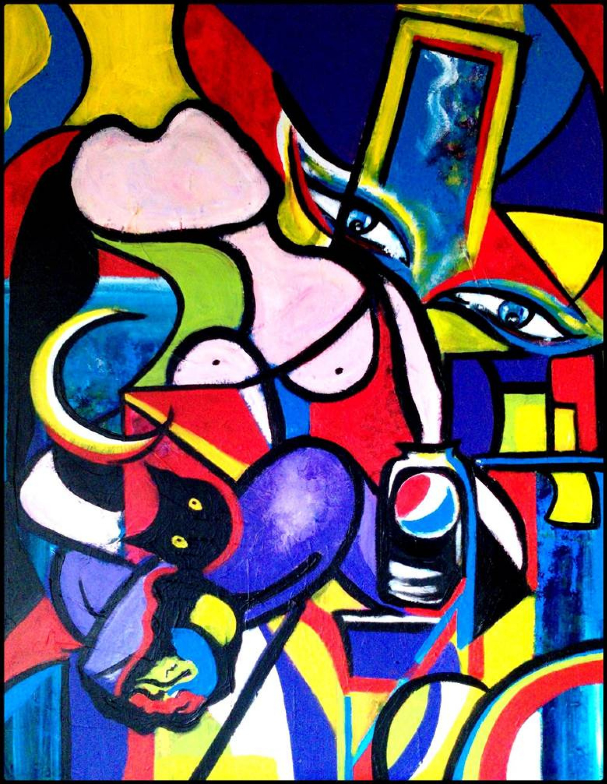

Slide 14
Abstract artists
Vasily Kandinsky (1866–1944)
Piet Mondrian (1872–1944)
Kazimir Malevich (1878–1935)
Lyubov Popova (1889–1924)
Mark Rothko (1903-1966)
Jackson Pollock (1912–1956)
Agnes Martin (1912–2004)
Joan Mitchell (1925–1992)

Slide 15
Why they are inspired
Some abstract artists create art for the sake of beauty, while others are inspired by the Greek philosopher Plato

Slide 16
Links to the videos
https://youtu.be/am4-XdUKR9g
https://youtu.be/z_l1HplDh_o

