Slide 1
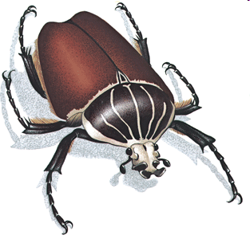

Slide 2


Slide 3
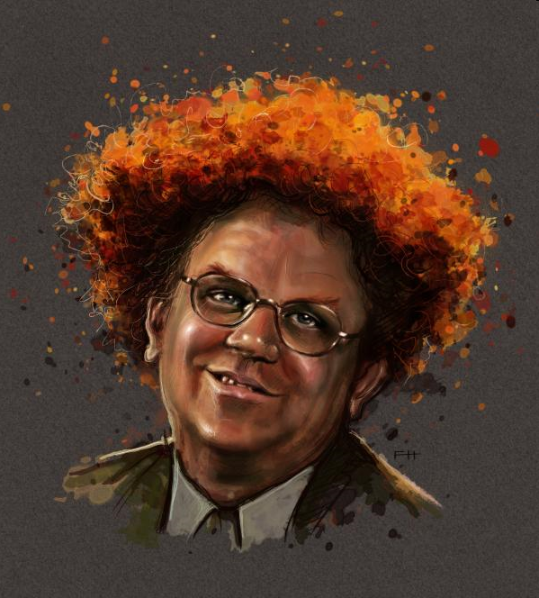

Slide 4

Sketch one only…

Slide 5


Slide 6


Slide 7
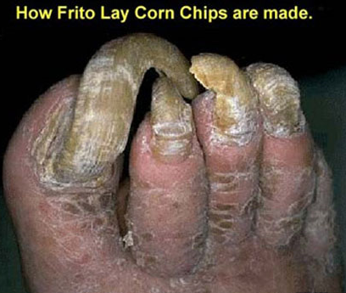
Sketch loose and fast…

Slide 8
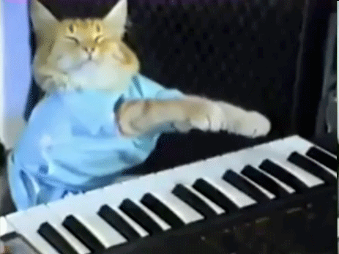
Add values (lights and darks)…

Slide 9
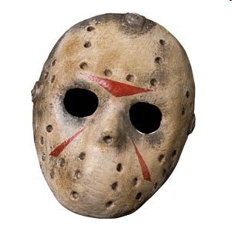
Add values (lights and darks)…

Slide 10
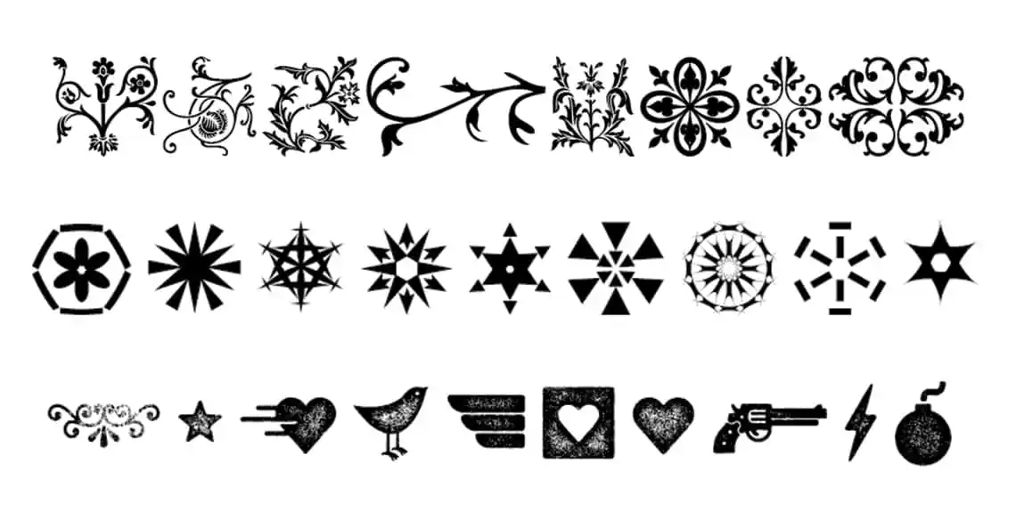
Sketch one or two…

Slide 11

Add values (lights and darks)…

Slide 12


Slide 13

Sketch one or two you dig…

Slide 14


Slide 15


Slide 16


Slide 17
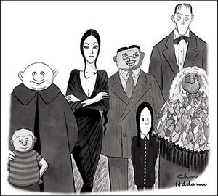
Sketch one only…

Slide 18


Slide 19


