Slide 1
FONTS
and
TYPEFACES

Slide 3
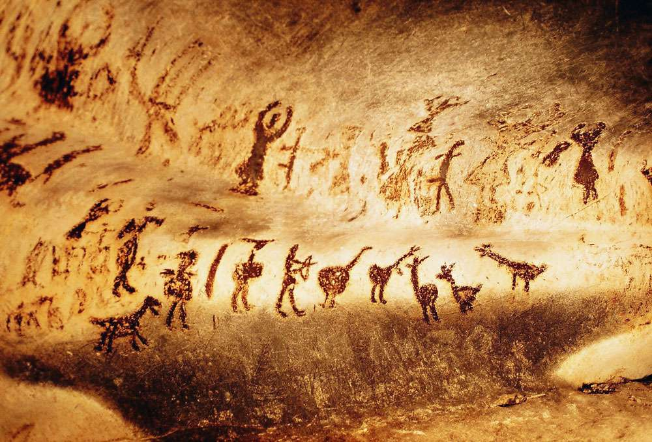
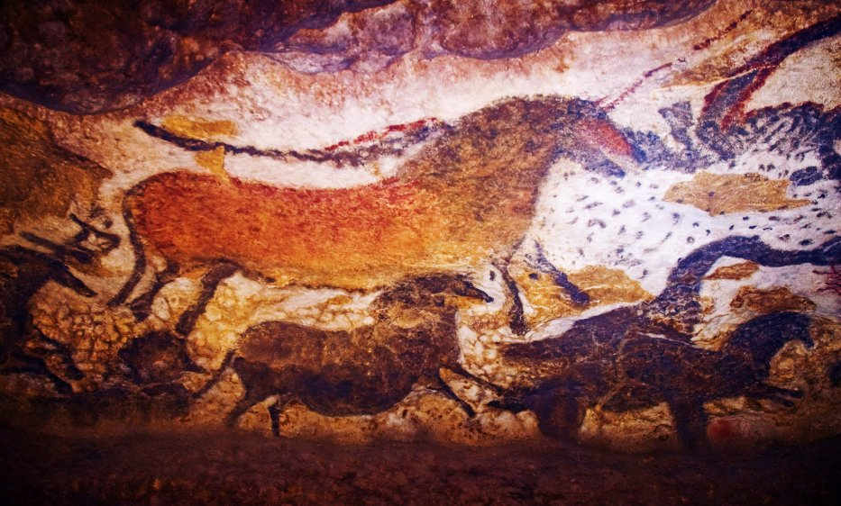
Early Human - Pictorial Signs - (Pictograms)
Pictograms are very simple drawings that represent things or ideas. This method of communication is still used today by certain civilizations including Chinese and Japanese and American Indians.
Video Link – The First Artworks – Cave Paintings

Slide 4
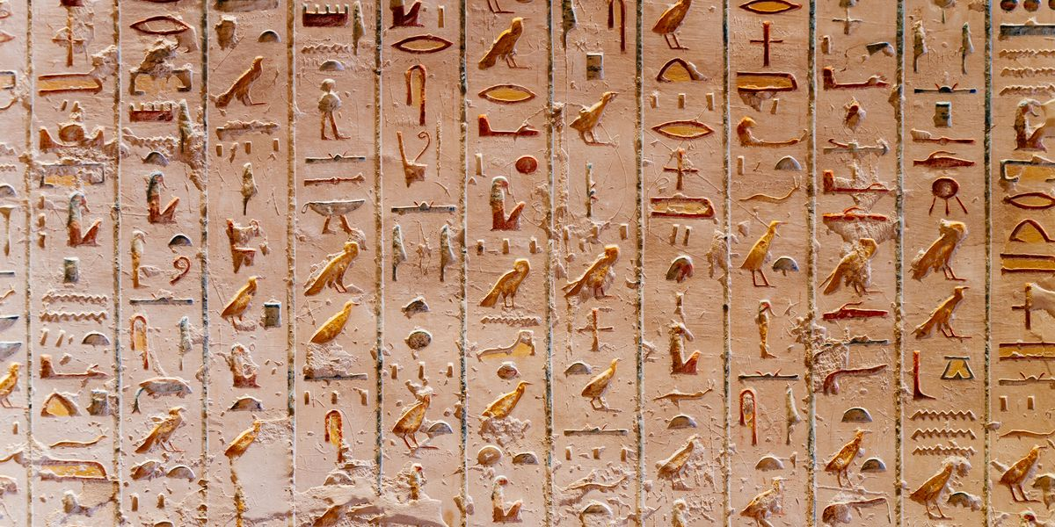
Early Human - Pictorial Signs - (Pictograms)
Pictograms can also be found in ancient Egyptian hieroglyphics.
Video: Egyptian Hieroglyphs

Slide 5
Origins Of The Alphabet

Slide 6
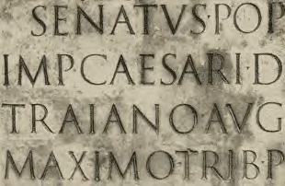
Latin Alphabet 1-400 AD
Adapted from Greeks by Romans in 114 AD, on the Trajan Column in Rome.
These Trajan capital letters have served, ever since, as a permanent criterion
for modern lettering. They were first sketched on stone with a broad brush, then incised with a chisel & mallet. Spurs on the end were chisel marks, later to become serifs.

Slide 7
Second Century Roman Inscriptional Letterforms
At this point in time there was no alternative to capital (majuscule) letters.
However, it is clear that these beautiful forms did have an influence on the
lowercase (minuscules) as they began to evolve during the following few centuries.

Slide 8
Gutenberg's Type, Circa 1440
The angular Gothic letter of Johann Gutenberg's type closely follows the style of handwriting practiced in Germany at the time.
Video: Heroes of Progress – Johan Guttenberg
Gutenberg first invented the process of printing from moveable type in 1440… one of the most monumental achievements of our civilization.
The next visual is a page from his famous 42-line Bible which was printed in two volumes between 1452 and 1455.

Slide 9
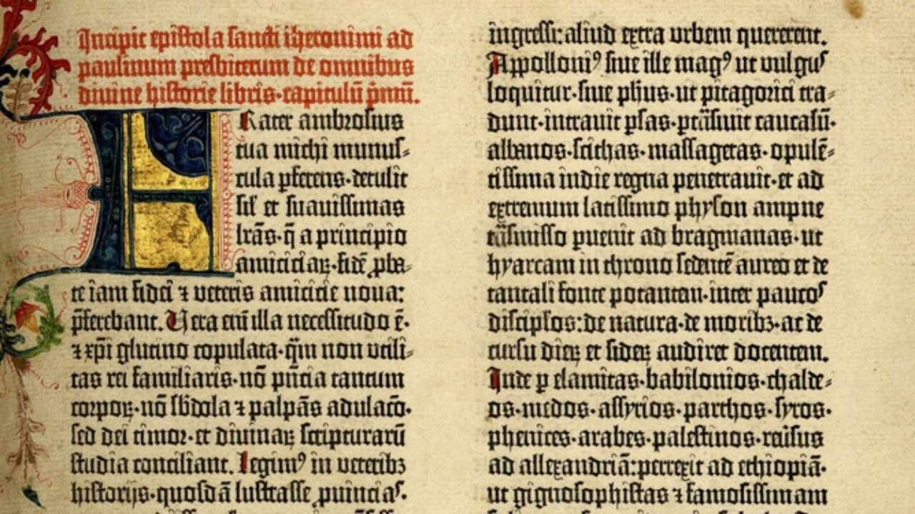

Slide 10
The Development of the Alphabet
From the time of the invention of printing in 1440 printers from this period were mostly scholars who welcomed the means to produce books.
Originally, books were meant ONLY for cultured men of certain social standing who became printers and who themselves undertook many of the operations within the printing process.
Video: Where Did The Alphabet Come From?

Slide 11
Anatomy Of Letters
2.
Booty
3.
1.
9.
4.
5.
8.
7.
6.

Slide 14
Identifying Styles and Types of Fonts

Slide 15
FONT CLASSICS - Serif Style
These are known as “traditional” style fonts
and are mostly used in books and magazines or
if you are trying to achieve a more refined look.

Slide 16
FONT CLASSICS - Sans Serif Style
These are known as “modern” style fonts
and are used very often on billboards, signs, logos
and on posters because of the fluid,
easy to recognize and understand design and style.
Arial
Eurostyle
Futura
Verdana
Verdana
Verdana
Verdana
Franklin Gothic Demi
Franklin Gothic Demi

Slide 17
FONT CLASSICS - Both Styles
The fonts most widely used online are known as
web safe fonts. Web Safe Fonts need to be readable across
Multiple platforms (PC and Mac).
With a monospace font, each letter takes up the same width and the rest
Sans Serif
Serif
Monospaced
Arial
Courier
Lucinda Console
Tahoma
Georgia
Monaco
Trebuchet
Times
Verdana

Slide 18
Helvetica
With the name Helvetica (Latin for Swiss), this font has the
objective and functional style which was associated with Swiss
typography in the 1950s and 1960s. It is perfect for international
correspondence: no ornament, no emotion, just clear
presentation of information. Helvetica is still one of the most
well-know sans-serif fonts in use today.

Slide 19
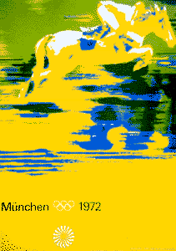
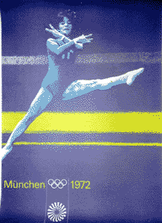
Notice the minimal use of text. Because of this your
eyes are drawn only to the information that’s most
important to the artist or client.

Slide 20
Text is measured in the following two ways.
VERTICAL (up and down) is measured in POINTS
28 Point - Joe Eats Paste
16 Point - Maddie also enjoys paste
50 Point - “Paste is delicious” - says Wednesday

Slide 21
HORIZONTAL (width) is measured in PICAS

Slide 22
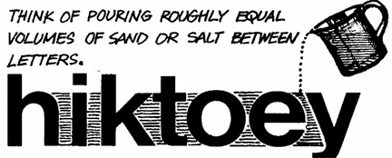
- measurements continued -

Slide 23
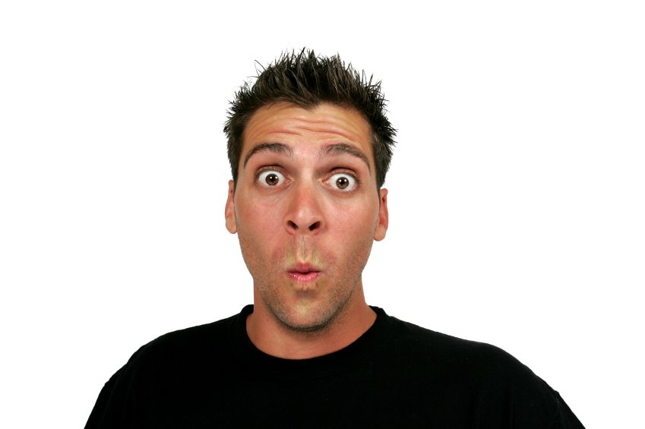
Which is correct?
I go to the outhouse at least three times per day.
I g o to the outhouse at least three times
pe r day.

Slide 24
- measurements continued -

Slide 25
- measurements continued -

Slide 26
- measurements continued -
S a i g e l i k e s w h e n g u y s w h i s t l e a t h i m
Gabby enjoys when guys whistle at her
Stephanie enjoys when guys whistle at her
Mr. Juul gets freaked out if girls whistle at him

Slide 27
- measurements continued -

Slide 28
- KINDS OF TYPE -
Headline Type sizes range from a minimum
of 14 points on up.

Slide 29
- HEADLINE EXAMPLES -

Slide 30
- HEADLINE EXAMPLES -
Why Does Alek Eat His Own Poop?
IT’S OFFICIAL!
TYLER TO WED HIMSELF!

Slide 31
- KINDS OF TYPE -

Slide 32
- BODY TYPE EXAMPLE -
Times New Roman
Garamond
Franklin Gothic Demi
Arial

Slide 33
- BODY TYPE EXAMPLE -
Which of these
fonts are easiest for
you to understand
and read?
? Know why ?
It’s what YOU are
most accustomed to… thus these fonts get used
most often.

Slide 34
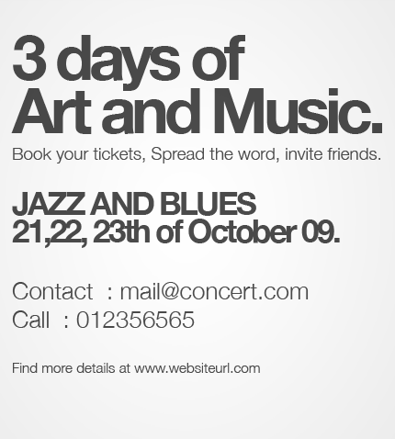
- HIERARCHY -
VISUAL HIERARCHY refers to the descending order of several fonts within a design.
The Headline is usually largest or has attention drawn to it using weight or color.
The information in or order of least importance follows.

Slide 35
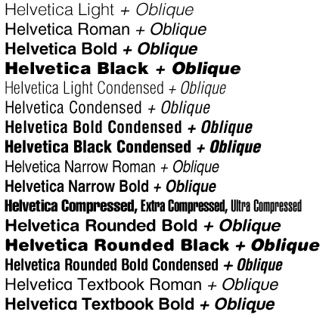
- FONT FAMILIES -
Consists of variations within one style of font.
Helvetica for example, has a huge family tree.
Some fonts may only have bold or italic versions

Slide 36
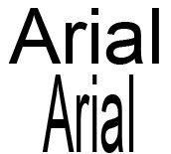
Summary.
Our current alphabet is made up of 26 distinct symbols that
represent thousands of years of evolution in design. As a
designer, you can modify, simplify or embellish these symbols
and forms, but you cannot change the basic shapes
without weakening communication.

Slide 37
Look through all the font links we have available online at www.juularts.com
Also check out www.Fonts.com
That is all for today spuds…

Slide 38
RECAP QUESTION TIME
What is TYPOGRAPHY
The Art Of Printing With or Design with Type
Who was JOHAN GUTENBERG
First invented the process of printing from movable type in 1440.
What did GUTENBERG’S invention help create in the Western World?
Books… Literacy… Schools… Critical Thinking… Individualism

Slide 39
RECAP continued
This style of serif font is mostly used in books and magazines
“Traditional”
With guideline strokes is known as?
SERIF
Without guideline strokes is known as?
SANS SERIF

Slide 40
RECAP continued
Text is measured in the following two ways.
POINTS which measures what?
Height
PICAS which measures what?
Width
KERNING
- Adjusting the space between letters
LINESPACING (LEADING)
- Adjusting the space between lines of text
WORDSPACING
- Adjusting the space between words

Slide 41
RECAP continued
HEADLINE TYPE is measured
in 14 POINTS and up
BODY TYPE is measured
up to 12 points and down

